Slide 1
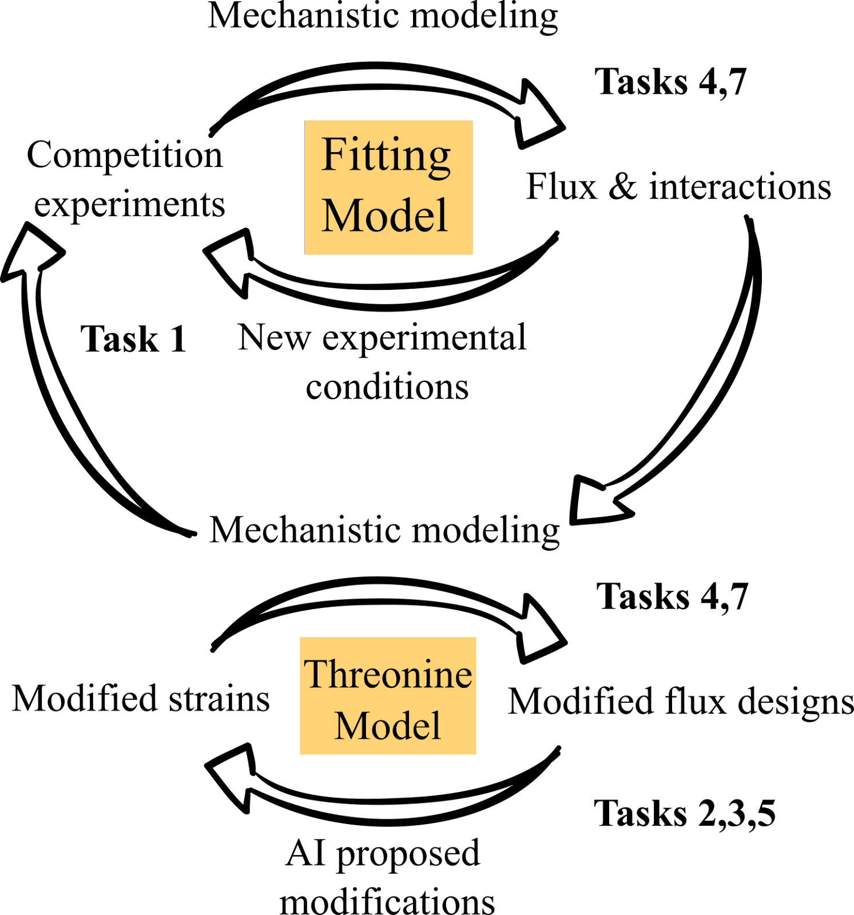
Mechanistic model-driven data integration
Task 4
Task 1
Experimental data fitting and design
Pathway flux, species interactions, growth kinetics
New experiment designs recommended to reduce model uncertainty/test hypotheses
Mechanistic model-driven design
Task 4
Metabolic engineering
Task 2,3
Task 2,3

